Slide 1
Bellabeat Case Study
An analysis of Fitbit users’ data to motivate consumer engagement with Bellabeat devices
9/9/2023

Slide 2


Slide 3
Business Task
What are some trends in Fitbit device usage, and how might these trends apply to Bellabeat customers?
How can these trends influence our marketing strategy?

Slide 4
Outline
Discuss data management, integrity checks, and cleaning process
Discuss key findings from analysis with visualizations
Suggest key recommendations

Slide 5
Data Source
Source link: FitBit Fitness Tracker Data | Kaggle

Slide 6
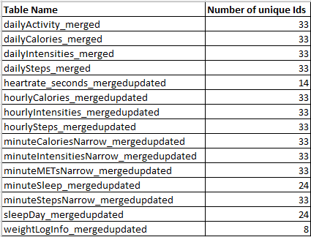
Data management/checking/cleaning
Manually update data using python to include times/dates in proper timestamp form. This was necessary for clean and streamlined uploading of all data tables to BigQuery.
Check number of unique user ids in each table.
Most table have data from all 33 participants. This shows that not all participants record all available metrics.
Check for records with null Ids (none!)

Slide 7
Questions to Inform Business Task
What are some basic statistics for metrics including daily steps, distance, calories, and level of activity?
At what time(s) during the day are users most active?
What are some important trends and non-trends, including calories v. distance travelled/steps taken, calories v. time asleep, etc?

Slide 8
Data Analysis Process
Obtain general statistical information (e.g. five-number summaries).
Filter/aggregate large data sets for producing plots.
Draw defensible conclusions from plots to answer previous questions and motivate business recommendations.

Slide 9
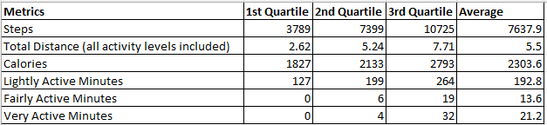
General Stats
BigQuery used to obtain 1st, 2nd, 3rd quartiles and means for daily steps, calories, distance, and activity levels. Values are from total data records, and is not grouped by participant Id or day.

Slide 10
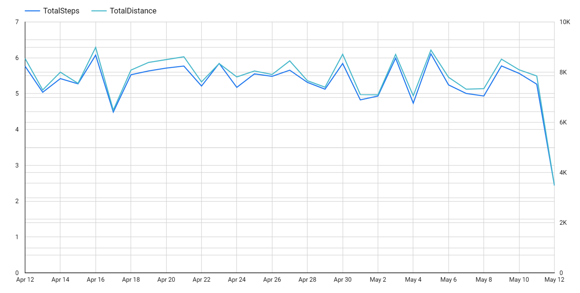
Average daily steps/distance

Slide 11
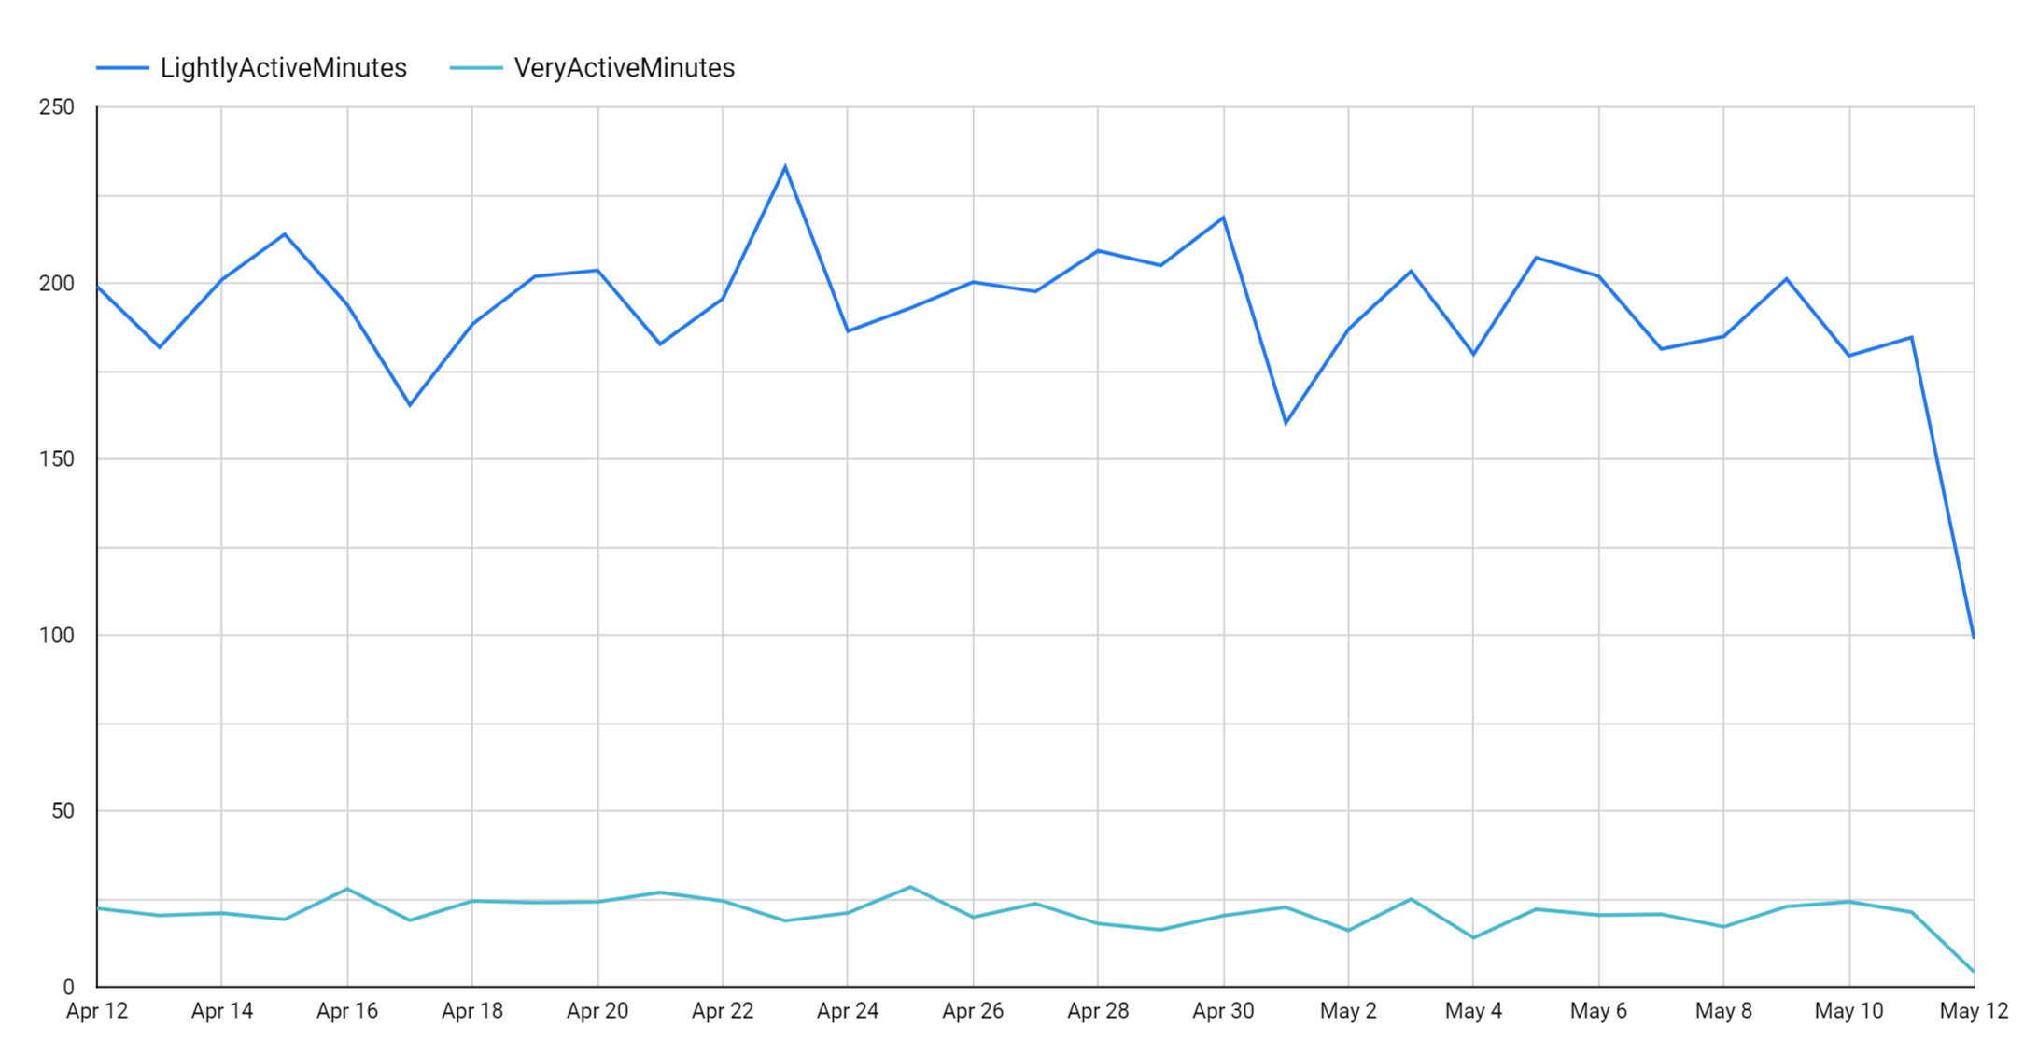
Average daily activity intensity

Slide 12
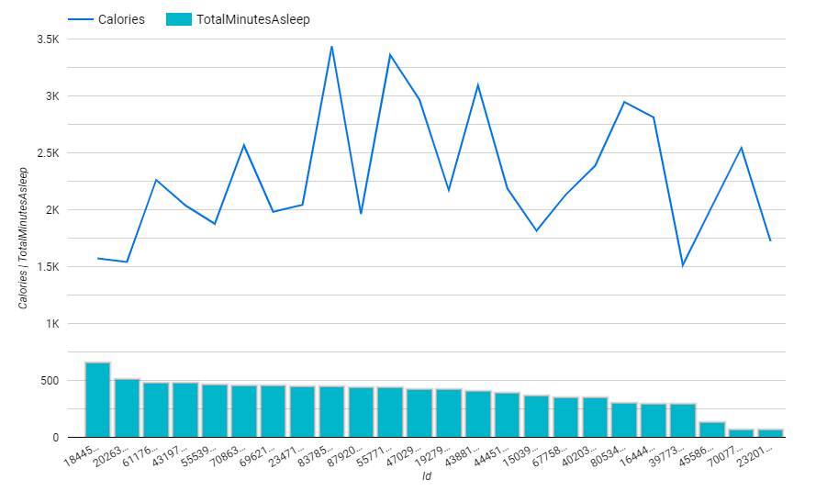
Calories and Sleep

Slide 13
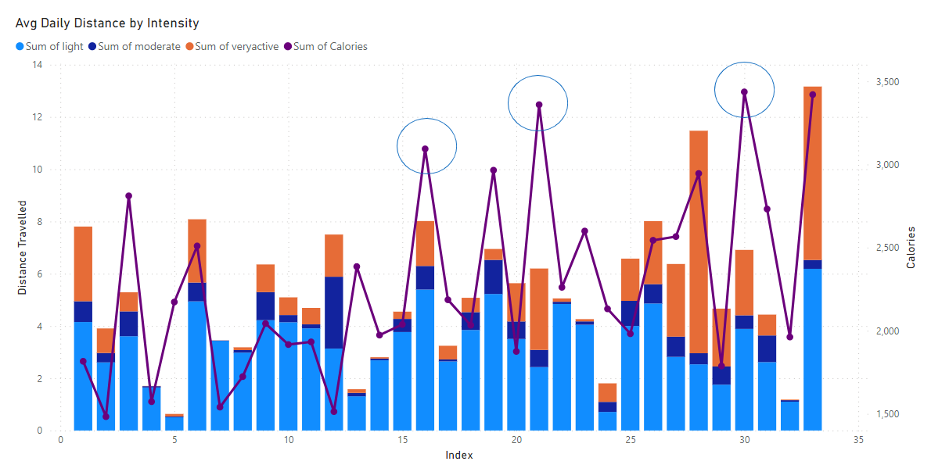
Calories and Active Distance

Slide 14
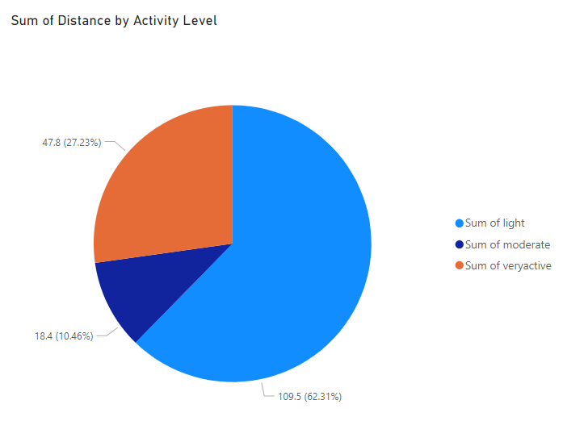
Overall Percentages of Active Distance

Slide 15
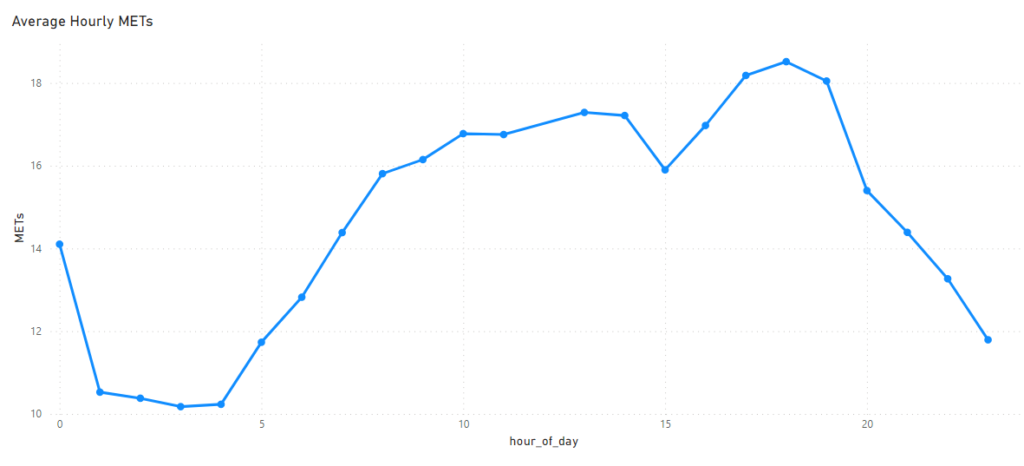
Activity by Time of Day

Slide 16
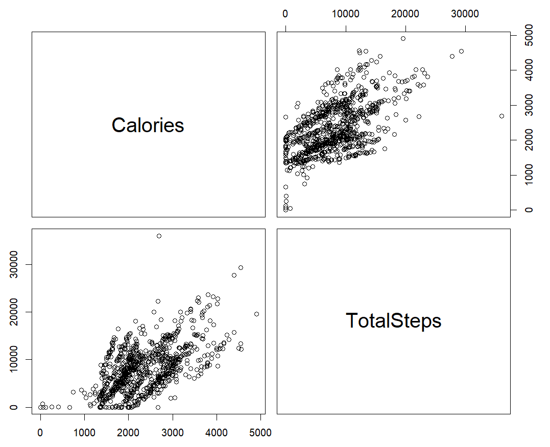
Important Trends

Slide 17
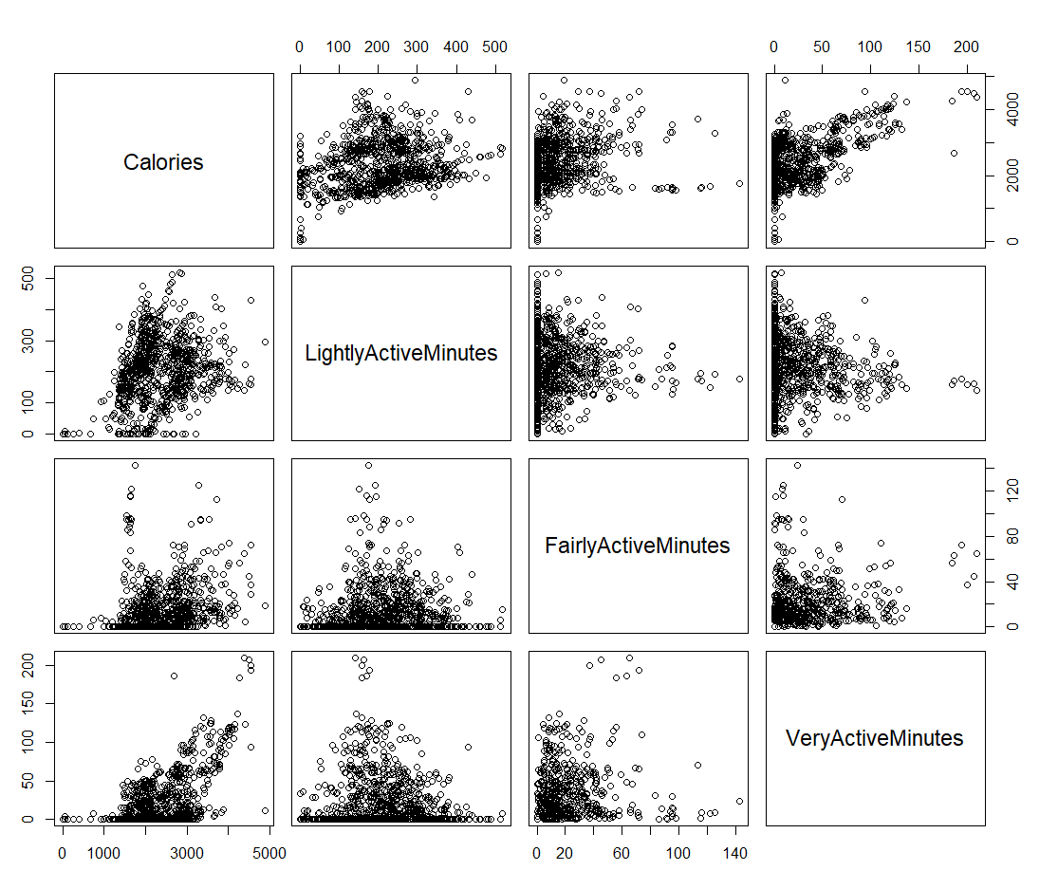

Slide 18
Conclusions and Recommendations
From summary table and plot, it appears that time of rigorous activity for users is small relative to total time of activity. It might be useful to include notification of app that will encourage users to increase their intense activity time once per day based on current level of rigorous time logged.
Users appears to do most of their rigorous exercise around 6 PM. We can add a notifications that reminds users around this time to add a rigorous workout.
Interestingly, total calories burned on average per day does not appear to influence time asleep. Nor does the total distance travelled and percentage of distance travelled under intense exertion appear to relate to total calories burned. This suggests that some users burning high calories might be doing more intense exercise with relatively little distance covered. It would be interesting to add functionality to the app that could give users more motivation for non-running or walking forms (such as weightlifting). (see circled points in combo plot of calories and active distance).
Overall trends indicate a positive correlation between lightly active minutes and calories and a stronger positive correlations between highly active minutes and calories.

Slide 19
Questions
??

